Slide 1

POWER EFFICIENCY USING MACHINE LEARNING
Geeked Out

Slide 2
Problem statement 3
Energy Audit for Households
The problem statement is aimed at building Machine Learning models to create energy consumption profiles for household and identify probable areas to plug wastage of energy in household.
Industries and big buildings are usually energy efficient as energy audits are regularly conducted and measures are taken to reduce the energy wastage. However, it is not true at the household levels. Most households may not go down the energy audit route for various reasons to assess the energy efficiency and energy usage of their homes.

Slide 3
GEEKEDOUT
TEAM DETAILS
Team name : GeekedOut
Team size : 4
Team members : 1. Gokula Krishnan R
2. Parthasarathy M V
3. Aniruth R
4. Sundara Ganapathy L
Department : Information Technology
College : Sri Sai Ram Engineering College

Slide 4


M V PARTHASARATHY
EXPERTISE AREAS : PRESENTATION AND ML PREDICTION
ROLE:
Writing code for developing ML Algorithms
Presentation works
R ANIRUDH
EXPERTISE AREAS : PAPER WORKS AND ML PREDICTION
ROLE:
Writing code for developing ML Algorithms
Paper works

Slide 5


R GOKULA KRISHNAN
EXPERTISE AREAS : WEB APPLICATION DEVELOPMENT
ROLE:
Web design
Linking Web page with API and also with Database
L SUNDARA GANAPATHY
EXPERTISE AREAS : DATABASE MANAGEMENT SYSTEM
ROLE:
Importing predicted values from flask to MySQL.
Retrieving the data from MySQL into webpage through python-flask

Slide 6





technology
MACHINE LEARNING (ML)
INTERNET OF THINGS(IOT)
platforms
PYTHON
DATABASE(MySQL)
Api’S
PYTHON – FLASK (server)
SCIKIT LEARN

Slide 7
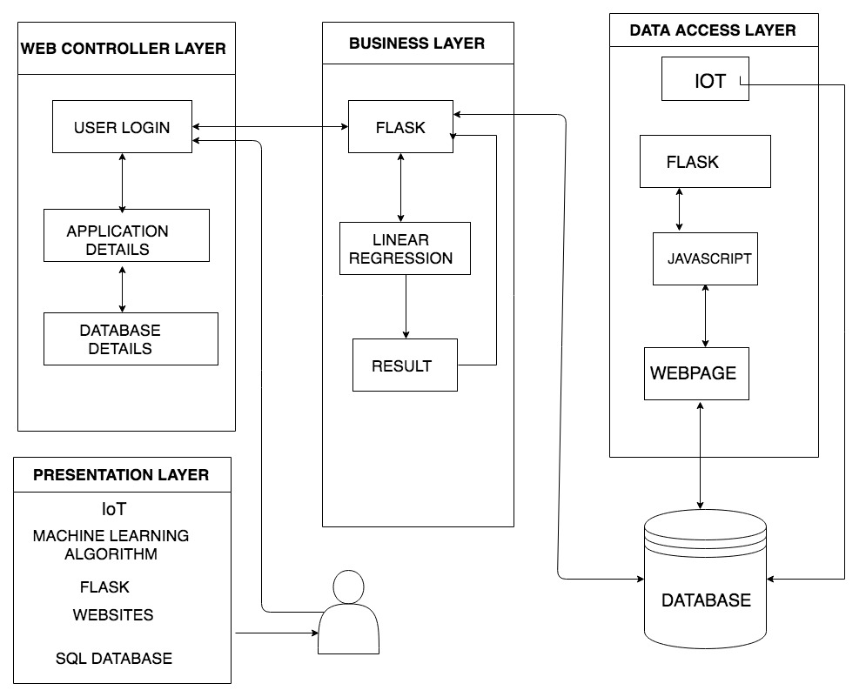
Architecture

Slide 8
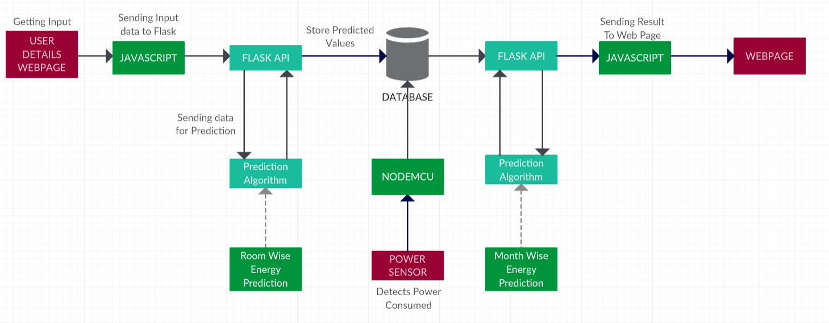
Data Flow diagram

Slide 9
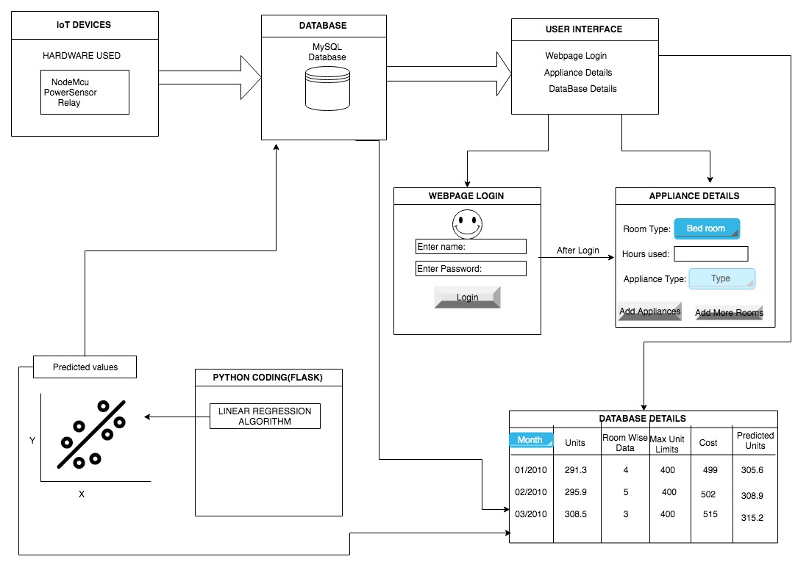
Workflow

Slide 10

Frameworks elaboration
Flask:
Flask is a micro web framework written in Python.
In this web application we used Flask to connect the Webpage with the Machine Learning model and the database.
SciKit-Learn:
SciKit-Learn is a Machine learning framework used for supervised and unsupervised machine learning algorithms.
SciKit-Learn Framework plays a vital role in our project for machine learning.
MatPlotLib:
MatPlotLib is an open source library for graphs and plotting.
We used this library for visualizing out dataset and get a better idea.
Pandas:
Pandas Framework is used for processing data easily.
Pandas is used to convert the data from database in to Data-frame on which machine learning model is applied.

Slide 11


